Slide 1
MIPS Binary Reverse Engineering Project
By: Jared Semke, Eli Ledford, and Adrian Dionicio Silva

Slide 2


Tools Used
https://student.cs.uwaterloo.ca/~cs241/mips/mipsref.pdf
https://courses.cs.washington.edu/courses/cse378/09wi/lectures/lec03.pdf
https://uweb.engr.arizona.edu/~ece369/Resources/spim/MIPSReference.pdf
https://edumips64.readthedocs.io/en/latest/instructions.html
https://www.cs.cornell.edu/courses/cs3410/2008fa/MIPS_Vol2.pdf
Buffer Overflow Attack with Example - GeeksforGeeks
Ghidra, Microsoft Visual Studio, and https://godbolt.org/ compiler

Slide 3
Introduction
The goal of the project is to take a C++ source code file put it into a reverse engineering tool.
This tool then takes the source code and translates it into the assembly language of the MIPS 32-bit processor.
We will then be explaining the meaning and understanding what each of the assembly instructions does.

Slide 4
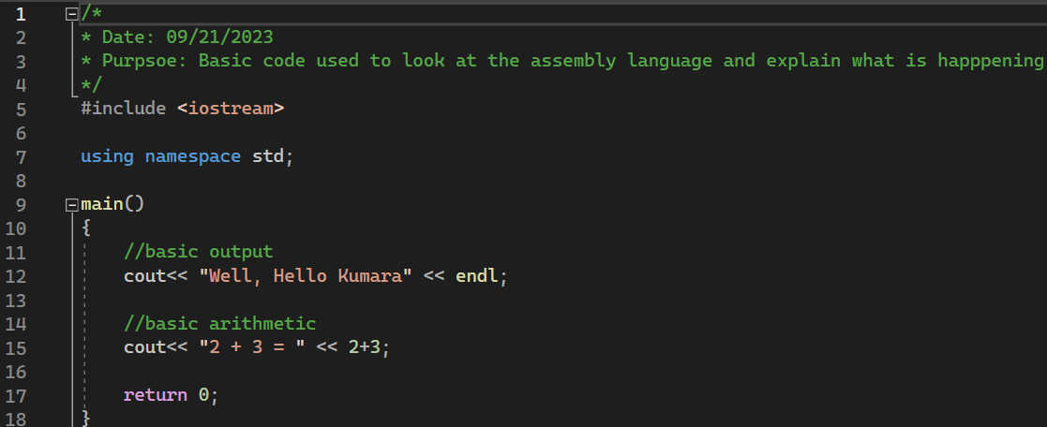
1st Source Code Used

Slide 5

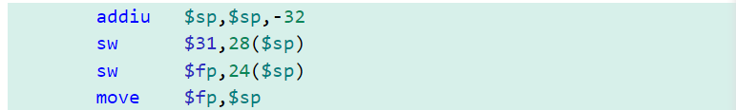
Code Breakdown 1
When the main function is entered, some of the values from the registers must be moved to main memory.
The stack pointer register value is then moved to the frame pointer register, but not before 32 is subtracted out of the stack pointer to reserve memory.

Slide 6

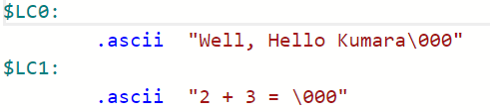
Pre-Analysis Before Entering Main Method
When the compiler compiles the program, it first scans for constant values. In our case, we have constant string literals in our output statements.
.LC0 and .LC1 represent the addresses of the strings from rodata (read-only data). This is data that doesn't change during runtime.
The .ascii instruction takes the given string and converts it to ascii values that can be understood by the CPU.
Notes:
ADD explanation for \000

Slide 7


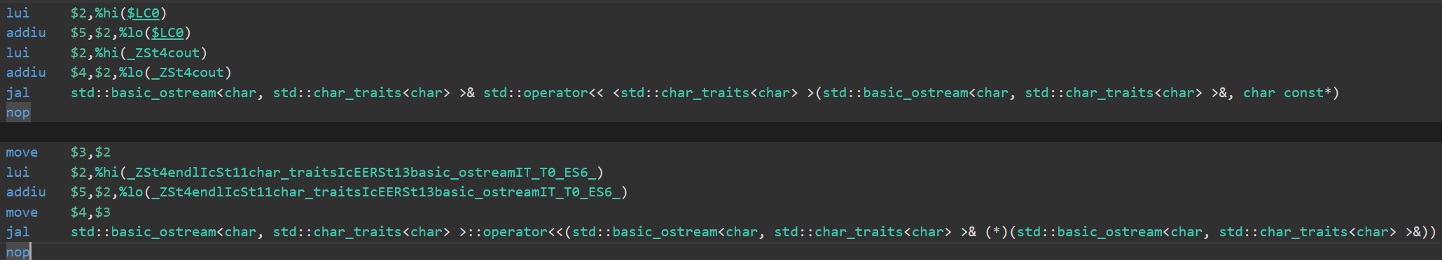



Code Breakdown 2
The cout is broken into 2 sections of instructions: the string literal, and the newline function(endl). For the first part of the cout, the upper 16 bits of the ro-data is loaded into register 2. The lower 16 bits of the ro-data is added to the higher data, then stored in register 5. The cout function data must be loaded into a register as well through the same process. Jal saves the return address in $ra and moves to the cout function. The contents that were in $2 are moved so the newline data can be stored and then executed with jal.

Slide 8


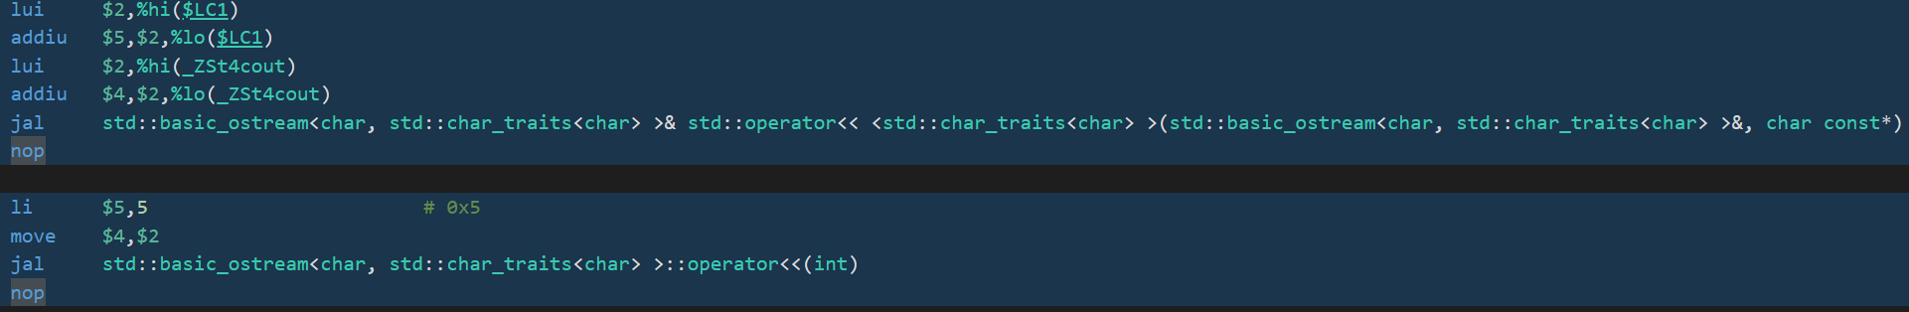



Code Breakdown 3
The same process that happened in the previous output statement happens here. The upper 16 bits of ro-data from $LC1 is loaded into $2, then the lower bits are added and stored in $5. The cout function has to be stored in registers as well, then called using jal. This prints out the string literal "2 + 3 = ". The li instructions loads an immediate value into $5, which is 5. The value of $2, which is the upper 16 bits of the cout function, are moved to $4. The function is once again called by jal to print 5 as the result.

Slide 9

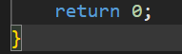
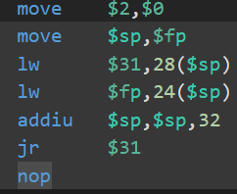
Code Breakdown 4
The line with return 0; corresponds with move $2, $0. This moves the value of $0, which is always 0, into $2. Similar to the opening brace of the function, the closing brace has many of the inverse instructions. The frame pointer value is moved into the stack pointer. The values from memory are being put back into registers, and 32 is added to the stack pointer to deallocate the memory. Jr jumps to the address stored in $31, signaling the end of the function.

Slide 10
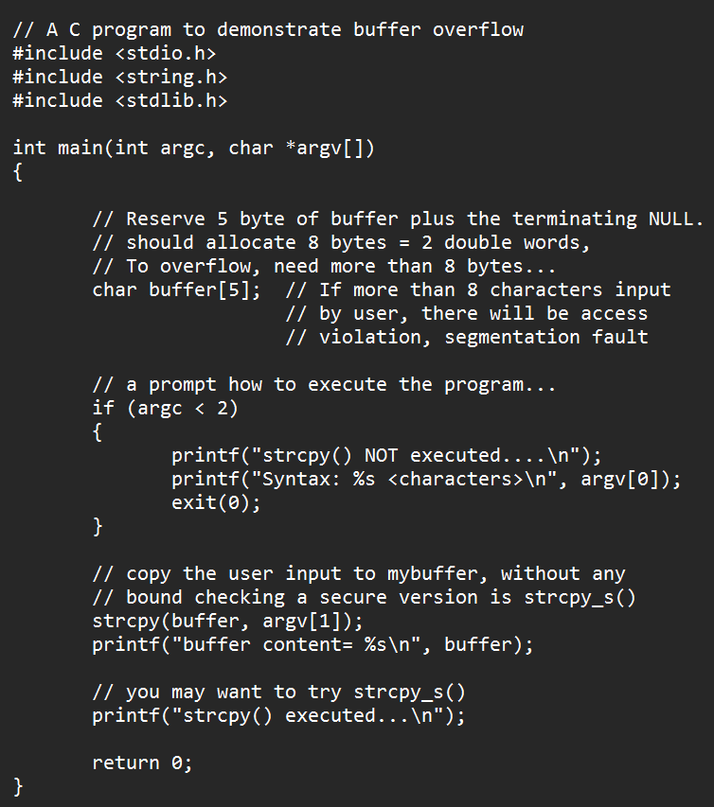
Buffer vulnerabilities example

Slide 11
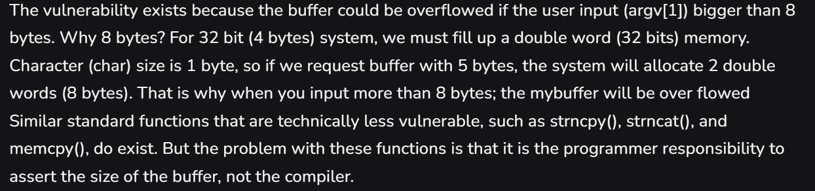
First Explanation of the source code:

Slide 12
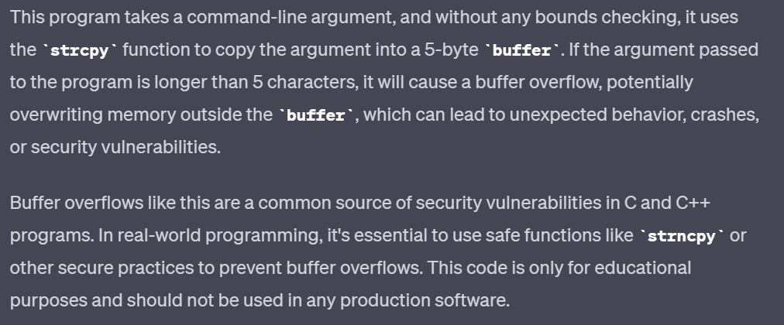
Second Explanation of the source code from chat GPT:

Slide 13
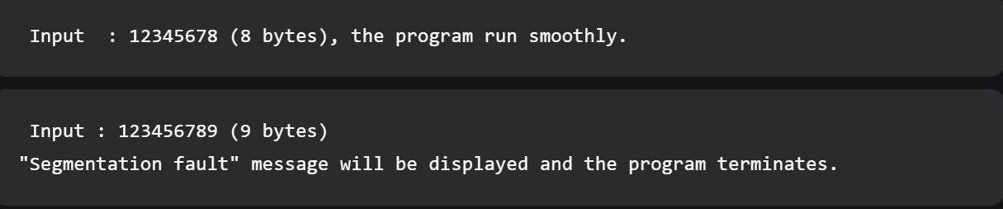
Input problems:

Slide 14
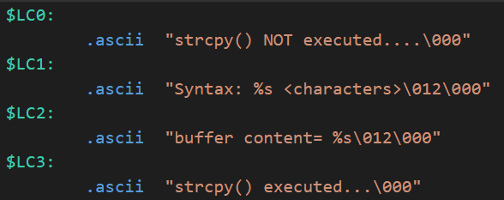
These are the strings stored in the ro-data before program execution.

Slide 15
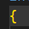
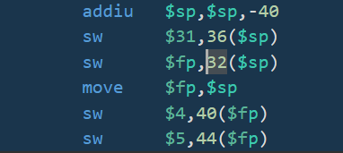
Code Breakdown 1
When the main function is entered, some of the values from the registers must be moved to main memory.​
The stack pointer register value is then moved to the frame pointer register, but not before 40 is subtracted out of the stack pointer to reserve memory.​

Slide 16
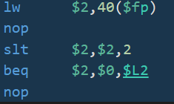
Code Breakdown 2
For the if statement, we first load the value at 40 +$fp to $2, which represents argc. Nop is used for a delay, and slt sets $2 to 1 if argc < 2, and set to 0 otherwise. Beq means branch to $L2 if $2 = $0. Remember that the value of $0 is always 0. Because of the slt instruction, the beq instruction is basically asking if argc < 2. The second nop is used for another delay after potential branch.

Slide 17
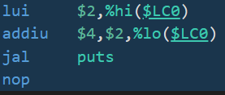
Code Breakdown 3
The first 2 instructions involve moving the ro-data so that it can be printed. The lui instruction loads the upper 16 bits of the ro-data into $2. The addiu instruction adds the lower 16 bits with the upper 16 bits stored in $2 and places the result in $4. The jal instruction then calls the puts function, which is the standard output function to the console. The nop instruction is used as a delay operation.

Slide 18
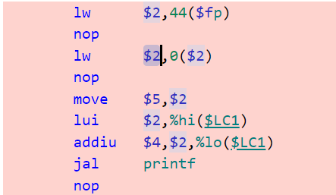
Code Breakdown 4
For the first lw instruction, the value at $fp + 44 is loaded into $2. nop is used for delay, and the value at $2 + 0 is loaded into $2. This represents argv[0]. Another nop is used for delay. $2 is then moved into $5. The upper 16 bits of the ro-data are loaded into $2, while the lower 16 bits are then added to the upper 16 and moved to $4. The jal instruction calls printf to print out the string to the console with argv[0] being placed into %s. nop delays the program one more time.

Slide 19
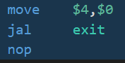
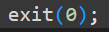
Code Breakdown 5
To exit the program, the value of $0 is moved to $4. This means that the value in $4 is 0 since $0 is 0. jal calls the exit function, which exits the program. The nop instruction causes a slight delay.

Slide 20
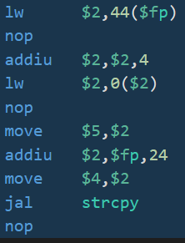
Code Breakdown 6
The value at 44 + $fp is loaded into $2. The nop operation is a delay. The value of $2 is added with 4. The value at $2 + 0 is loaded into $2. These instructions correspond with the argv[1] being loaded into the register. Another nop for delay is present. $2 ends up being moved to $5 to free up space. $fp is then added with 24, with the result being stored in $2. That value in $2 is then moved into $4. This is where the buffer resides. The jal instruction calls the strcpy function. The nop causes a final delay.

Slide 21
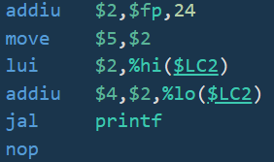
Code Breakdown 7
The first 2 instructions load the buffer into a register. $fp is added with 24 and stored in $2, which is then moved into $5. The next 2 instructions moves the upper 16 bits of the ro-data and then adds the lower 16 bits into $4. The printf function is then called using jal, followed by a delay with nop.

Slide 22
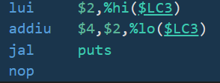
Code Breakdown 8
The first 2 instructions load the upper 16 bits of ro-data into $2, then add the lower 16 bits to the upper 16 and store in $4. Once the data is loaded, the jal instruction calls the puts function that outputs the string to the console.

Slide 23
Code Breakdown 9
The line with return 0; corresponds with move $2, $0. This moves the value of $0, which is always 0, into $2.

Slide 24
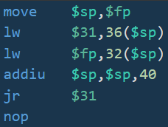
Code Breakdown 10
Similar to the opening brace of the function, the closing brace has many of the inverse instructions. The frame pointer value is moved into the stack pointer. The values from memory are being put back into registers, and 40 is added to the stack pointer to deallocate the memory. Jr jumps to the address stored in $31, signaling the end of the function.

Slide 25
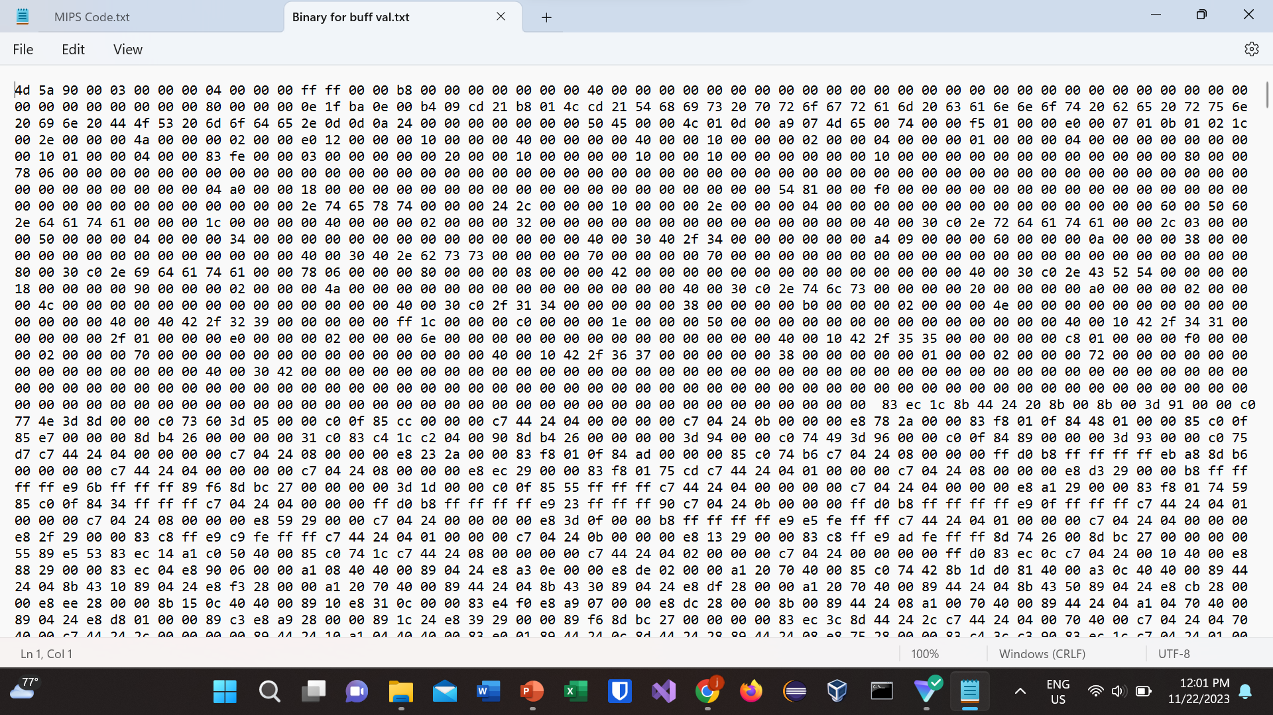
Binary Representation of MIPS Assembly Code:
See the attached File in Canvas labeled "Binary dump of a.xe .txt"
File not included in presentation because binary representation was too long
Preview:

Slide 26
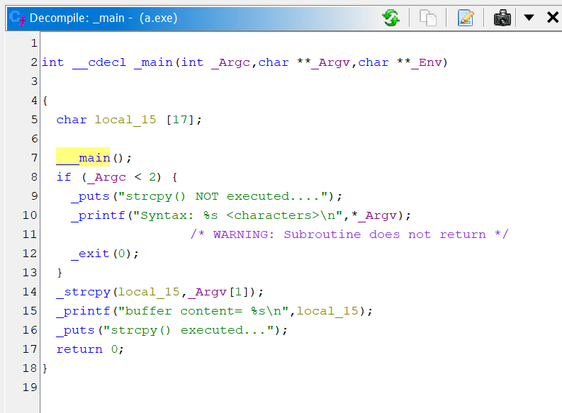
Reverse Engineer back to Source Code from Binary in Ghidra

Slide 27
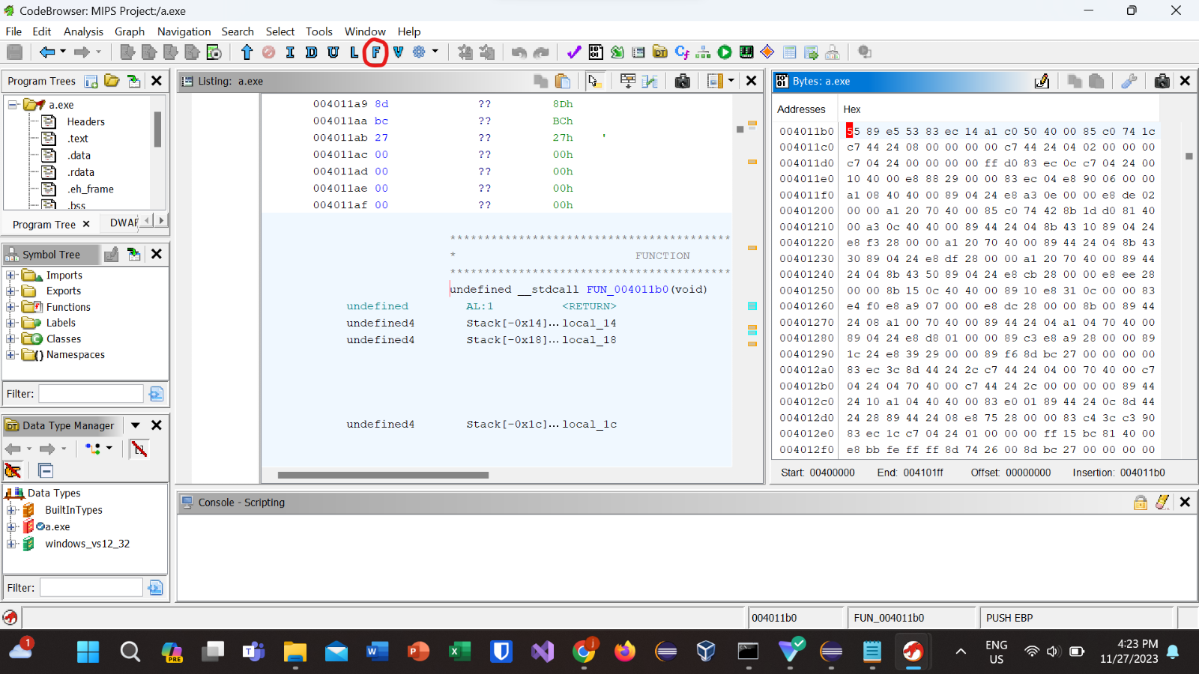
Finding the Main Function Call in Ghidra
To find the call of the main method in the binary from Ghidra, we use the find next function button on the top bar, which takes the cursor to the function call in binary:

Slide 28
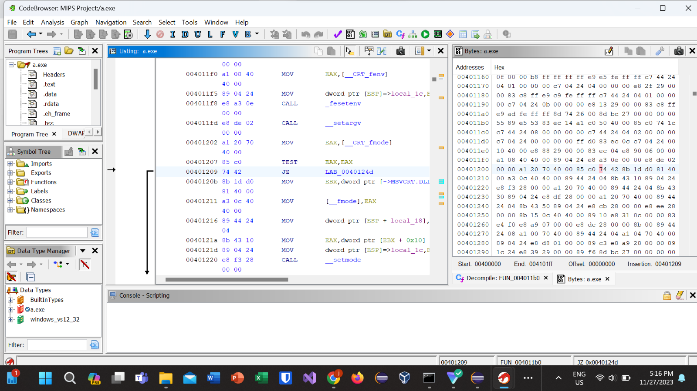
Finding Control Structures in Ghidra
To find control structures, use decompile, then find the control expression in the source code. Stay on the highlighted assembly line that corresponds to the control structure, then pull up the binary. Click on the assembly instruction again, and that will take you to the instruction in binary:

Slide 29


Thanks for Listening

